Slide 1
The Web Application
Raj Krishnan

Slide 2
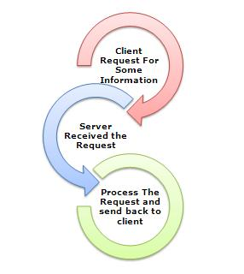
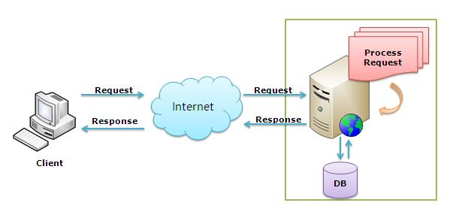
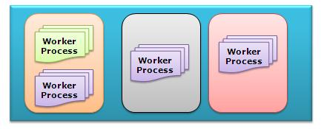
Running a Web Application
Processing an incoming request to Web Server
Application Pool
Notes:
What is Web server and IIS is and what is the use of them. Now let’s have a look how they do things internally. Before we move ahead, you have to know about two main concepts 1. Worker Process 2. Application Pool
Worker Process: Worker Process (w3wp.exe) runs the ASP.Net application in IIS. This process is responsible to manage all the request and response that are coming from client system. All the ASP.Net functionality runs under the scope of worker process. When a request comes to the server from a client worker process is responsible to generate the request and response. In a single word we can say worker process is the heart of ASP.NET Web Application which runs on IIS. Application Pool: Application pool is the container of worker process. Application pools is used to separate sets of IIS worker processes that share the same configuration. Application pools enables a better security, reliability, and availability for any web application. The worker process serves as the process boundary that separates each application pool so that when one worker process or application is having an issue or recycles, other applications or worker processes are not affected. This makes sure that a particular web application doesn't not impact other web application as they they are configured into different application pools.

Slide 3
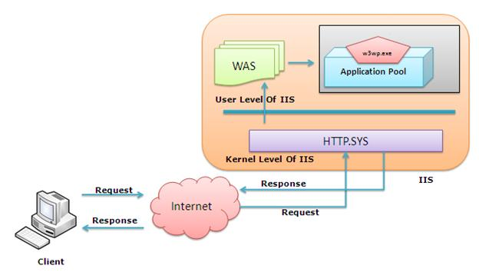
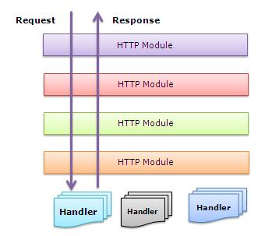
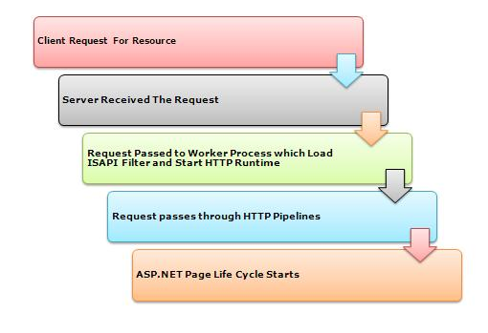
Application Lifecycle
Notes:
If we look into the IIS 6.0 Architecture, we can divided them into Two Layer 1. Kernel Mode 2. User Mode Now, Kernel mode is introduced with IIS 6.0, which contains the HTTP.SYS. So whenever a request comes from Client to Server, it will hit HTTP.SYS First.
Now, HTTP.SYS is Responsible for pass the request to particular Application pool. Now here is one question, How HTTP.SYS comes to know where to send the request? This is not a random pickup. Whenever we creates a new Application Pool, the ID of the Application Pool is being generated and it’s registered with the HTTP.SYS. So whenever HTTP.SYS Received the request from any web application, it checks for the Application Pool and based on the application pool it send the request.
Till now, Client Requested for some information and request came to the Kernel level of IIS means at HTTP.SYS. HTTP.SYS has been identified the name of the application pool where to send. Now, let’s see how this request moves from HTTP.SYS to Application Pool. In User Level of IIS, we have Web Admin Services (WAS) which takes the request from HTTP.SYS and pass it to the respective application pool.
When Worker process loads the aspnet_isapi.dll, it start an HTTPRuntime, which is the entry point of an application. HTTPRuntime is a class which calls the ProcessRequest method to start Processing.
After that HttpRuntime load an HttpApplication object with the help of HttpApplicationFactory class.. Each and every request should pass through the corresponding HTTPModule to reach to HTTPHandler, this list of module are configured by the HTTPApplication. Now, the concept comes called “HTTPPipeline”. It is called a pipeline because it contains a set of HttpModules ( For Both Web.config and Machine.config level) that intercept the request on its way to the HttpHandler. HTTPModules are classes that have access to the incoming request. We can also create our own HTTPModule if we need to handle anything during upcoming request and response.
HTTP Handlers are the endpoints in the HTTP pipeline. All request that are passing through the HTTPModule should reached to HTTPHandler. Then HTTP Handler generates the output for the requested resource. So, when we requesting for any aspx web pages, it returns the corresponding HTML output. All the request now passes from httpModule to respective HTTPHandler then method and the ASP.NET Page life cycle starts. This ends the IIS Request processing and start the ASP.NET Page Lifecycle.

Slide 4
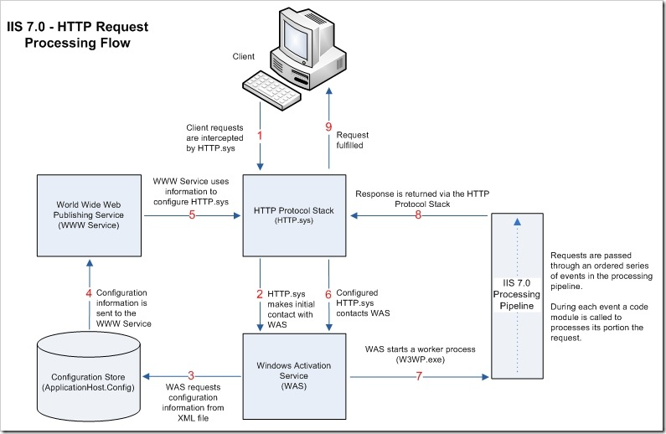

Slide 5
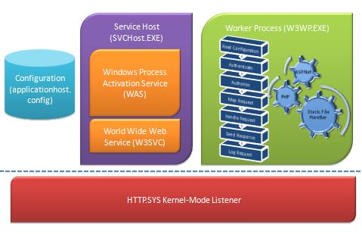
IIS Request Flow

Slide 6
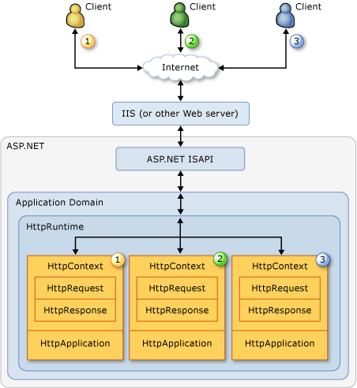
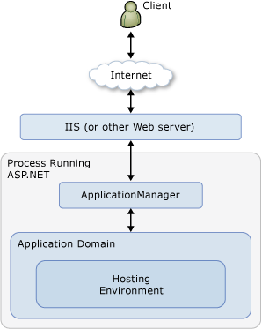
Application Lifecycle
ASP/NET Request
Application Environment
Request processing – Module, Handler, Page Event
Notes:
ASP.NET creates an environment which can process the request. It creates the application object, request, response and context objects to process the request.

Slide 7
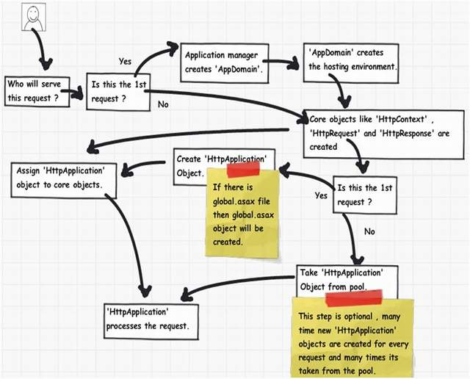
ASP.NET Application Life Cycle

Slide 8
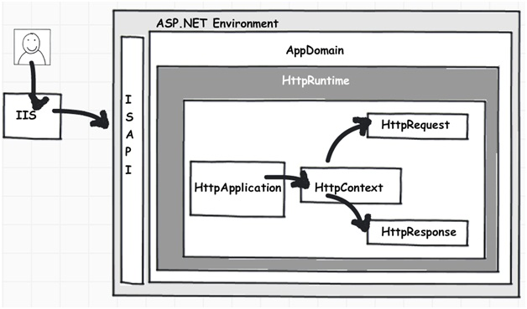
ASP.NET Life Cycle
Notes:
Once ‘HttpApplication’ is created, it starts processing requests. It goes through 3 different sections ‘HttpModule’ , ‘Page’ and ‘HttpHandler’. As it moves through these sections, it invokes different events which the developer can extend and add customize logic to the same.
To precompile an ASP.NET Web site in place
Open a command window and navigate to the folder containing the .NET Framework.
The .NET Framework is installed in the following location.
Copy
%windir%\Microsoft.NET\Framework\version
Run the aspnet_compiler command by typing the following at a command prompt.
Copy
aspnet_compiler -v /virtualPath
The virtualPath parameter indicates the Internet Information Services (IIS) virtual path of your Web site.
If your Web site is not an IIS application, and therefore has no entry in the IIS metabase, type the following command at a command prompt.
Copy
aspnet_compiler -p physicalOrRelativePath -v /
In this case, the physicalOrRelativePath parameter refers to the fully qualified directory path in which the Web site files are located, or a path relative to the current directory. The period (.) operator is allowed in the physicalOrRelativePath parameter. The -v switch specifies a root that the compiler will use to resolve application-root references (for example, with the tilde (~) operator). When you specify the value / for the -v switch, the compiler will resolve the paths by using the physical path as the root.

Slide 9
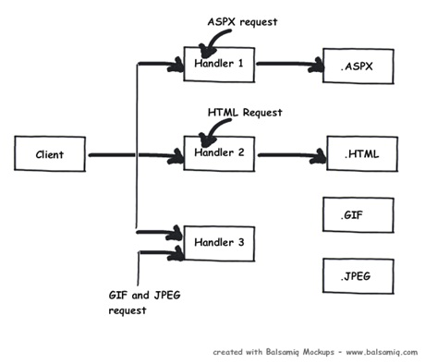
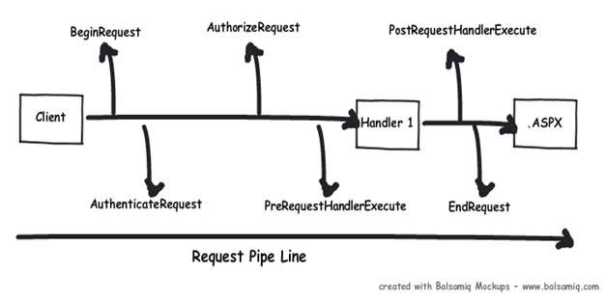
HttpHandler & HttpModule
Notes:
‘HttpModule’ and ‘HttpHandlers’. help us to inject custom logic before and after the ASP.NET page is processed. The main differences between both of them are:
If you want to inject logic based in file extensions like ‘.ASPX’, ‘.HTML’, then you use ‘HttpHandler’. In other words, ‘HttpHandler’ is an extension based processor.
you want to inject logic in the events of ASP.NET pipleline, then you use ‘HttpModule’. ‘HttpModule’ is an event based processor.

Slide 10
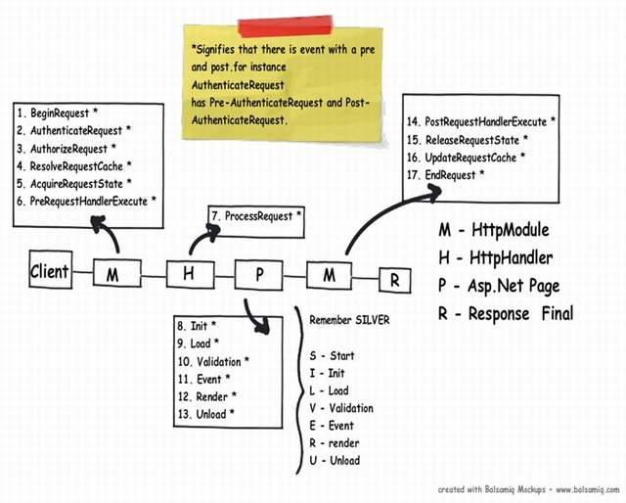
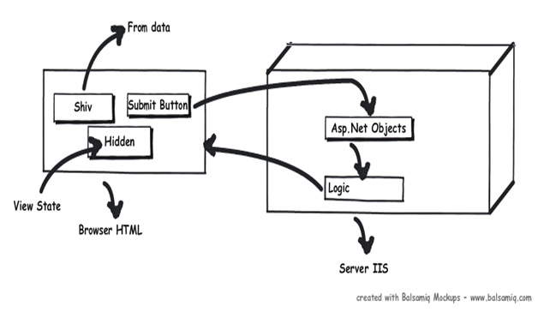
MHPM
Notes:
Step 1(M: HttpModule): Client request processing starts. Before the ASP.NET engine goes and creates the ASP.NET HttpModule emits events which can be used to inject customized logic. There are 6 important events which you can utilize before your page object is created BeginRequest, AuthenticateRequest, AuthorizeRequest, ResolveRequestCache, AcquireRequestState and PreRequestHandlerExecute. Step 2 (H: ‘HttpHandler’): Once the above 6 events are fired, ASP.NET engine will invoke ProcessRequest event if you have implemented HttpHandler in your project. Step 3 (P: ASP.NET page): Once the HttpHandler logic executes, the ASP.NET page object is created. While the ASP.NET page object is created, many events are fired which can help us to write our custom logic inside those page events. There are 6 important events which provides us placeholder to write logic inside ASP.NET pages Init, Load, validate, event, render and unload. You can remember the word SILVER to remember the events S – Start (does not signify anything as such just forms the word) , I – (Init) , L (Load) , V (Validate), E (Event) and R (Render). Step4 (M: HttpModule): Once the page object is executed and unloaded from memory, HttpModule provides post page execution events which can be used to inject custom post-processing logic. There are 4 important post-processing events PostRequestHandlerExecute, ReleaserequestState, UpdateRequestCache and EndRequest. The below figure shows the same in a pictorial format.
BeginRequest: Request has been started. If you need to do something at the beginning of a request (for example, display advertisement banners at the top of each page), synchronize this event.
AuthenticateRequest: If you want to plug in your own custom authentication scheme (for example, look up a user against a database to validate the password), build a module that synchronizes this event and authenticates the user how you want to.
AuthorizeRequest: This event is used internally to implement authorization mechanisms (for example, to store your access control lists (ACLs) in a database rather than in the file system). Although you can override this event, there are not many good reasons to do so.
ResolveRequestCache: This event determines if a page can be served from the Output cache. If you want to write your own caching module (for example, build a file-based cache rather than a memory cache), synchronize this event to determine whether to serve the page from the cache.
AcquireRequestState: Session state is retrieved from the state store. If you want to build your own state management module, synchronize this event to grab the Session state from your state store.
PreRequestHandlerExecute: This event occurs before the HTTP handler is executed.
PostRequestHandlerExecute: This event occurs after the HTTP handler is executed.
ReleaseRequestState: Session state is stored back in the state store. If you are building a custom session state module, you must store your state back in your state store.
UpdateRequestCache: This event writes output back to the Output cache. If you are building a custom cache module, you write the output back to your cache.
EndRequest: Request has been completed. You may want to build a debugging module that gathers information throughout the request and then writes the information to the page

Slide 11
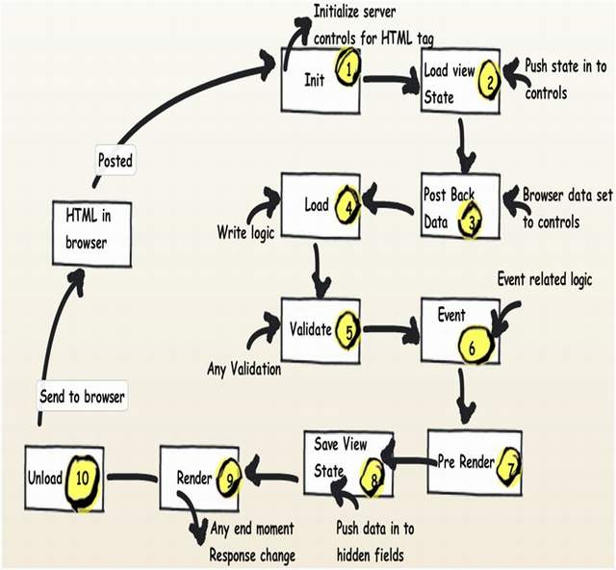
Page Life Cycle

Slide 12
MHPM
Demo Link

Slide 13
Custom Module

Slide 14
The Web Browser
Send Request to Web Browser
Resolve DNS Address, Use Http to connect to the server and request a page
Server Authentication (SSL)
Process Response (HTML, images, video, animation, error, redirection …)
Display HTML and embedded objects
Run Clinet Scripts

Slide 15
HTTP Status Code
1xx – Informational
2xx –Success
3xx – Redirect
4xx – Client Error
5xx – Server Error

Slide 16
Creating Web Site
New Web Site – File, FTP and HTTP
Web Site VS Web Application
WEB Application | Web Site
A project file is created with information about files and references | No project file is created
Compile using tools and an assembly is created | Dynamic compilation and multiple assemblies
Namespace added | Add Manually
Compile application and copy assembly to server; use tools for web deploy | copy the application source files to a computer that has IIS installed on it.

